Slide 1
CRIME IN CONTEXT IN US (1975 TO 2015), ARE VIOLENT CRIME RATES RISING OR FALLING IN AMERICAN CITIES?
By PREETI MONDAL
ROLL NO: 183031-11-0199
REGISTRATION NO: 031-1212-0369-18

Slide 2
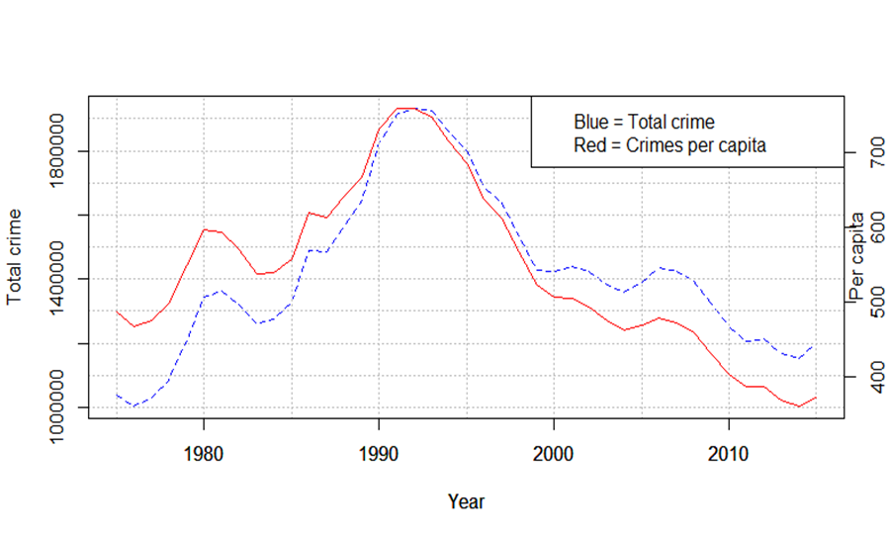
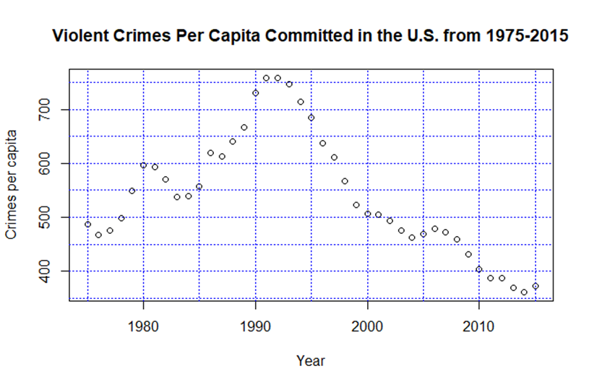
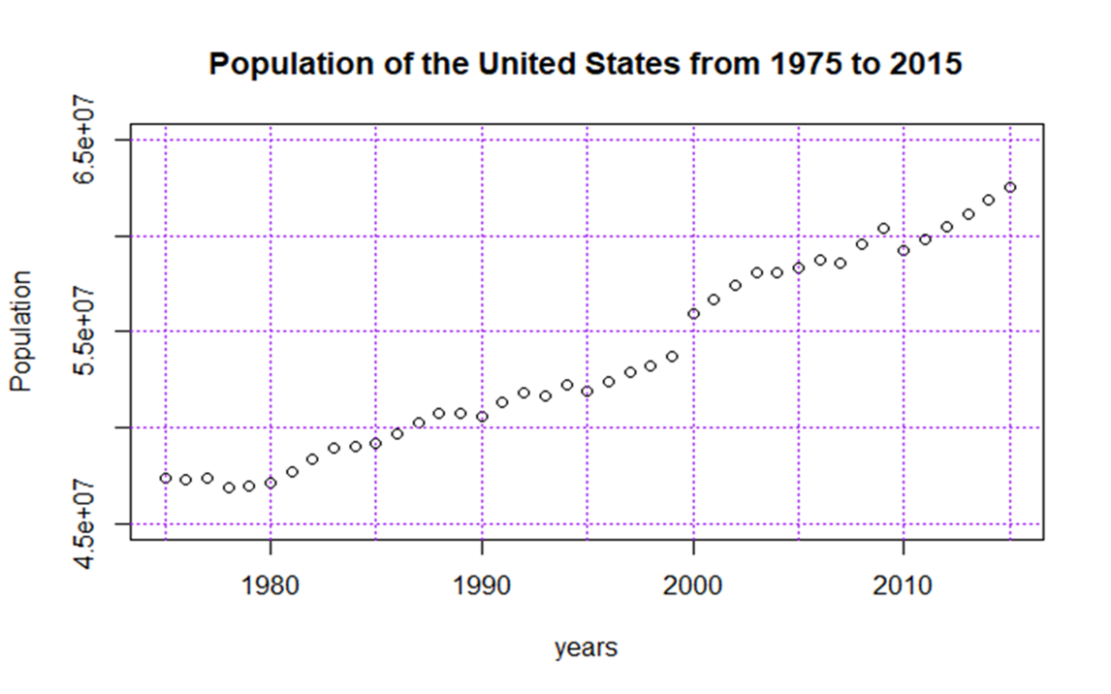
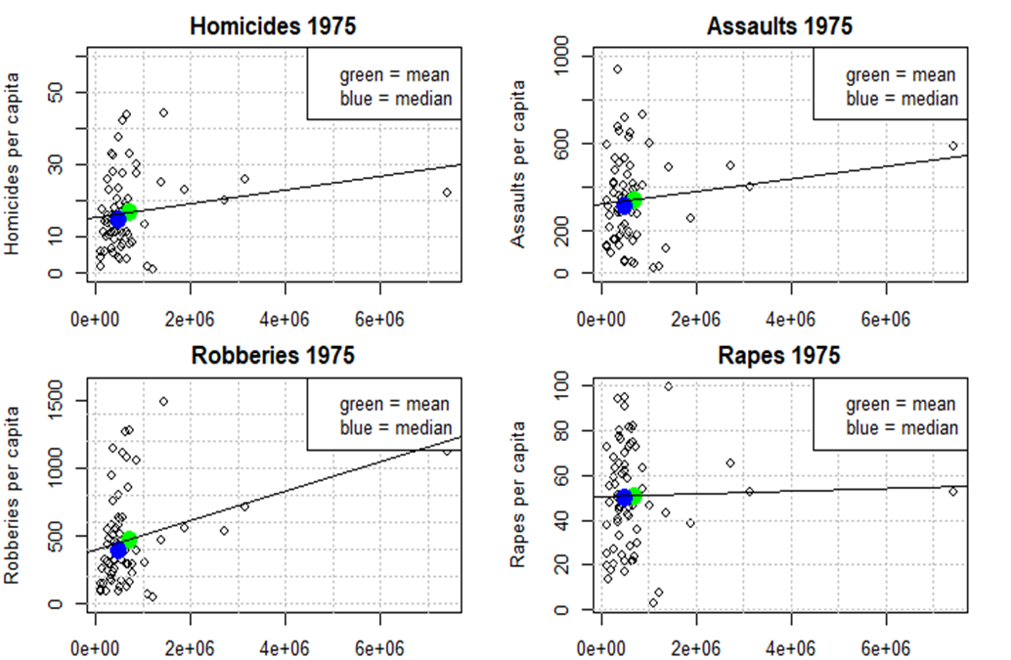
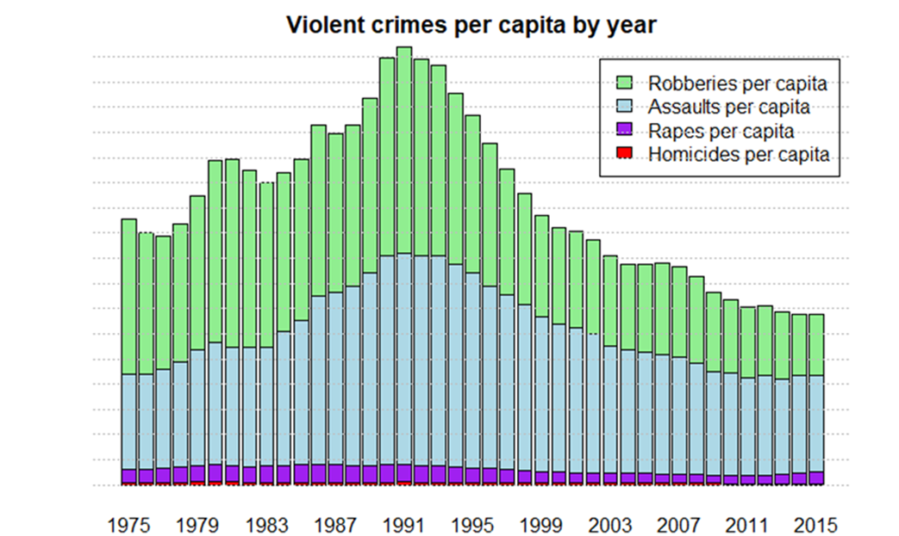
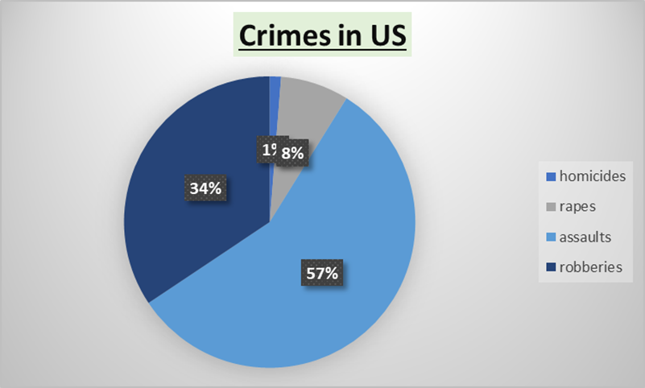
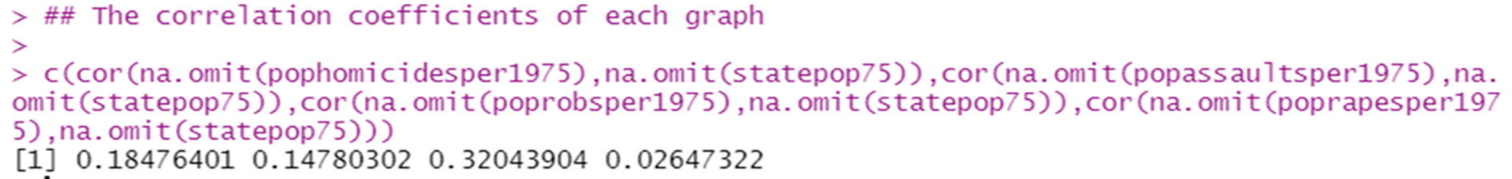
Plot years against rate of violent crime in the United States
Plot years against population of the United States
Total Crime in years & Crimes per capita
Specific violent crimes committed per capita each year.
PLOTTING A PIE CHART

Slide 3
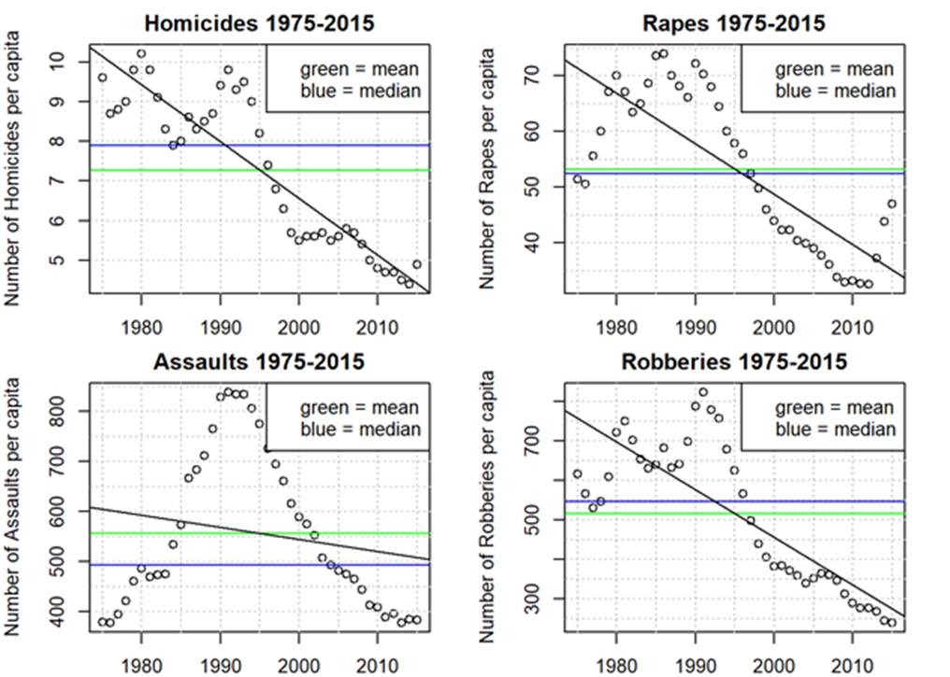
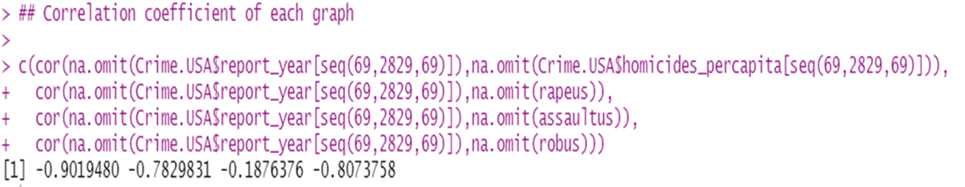
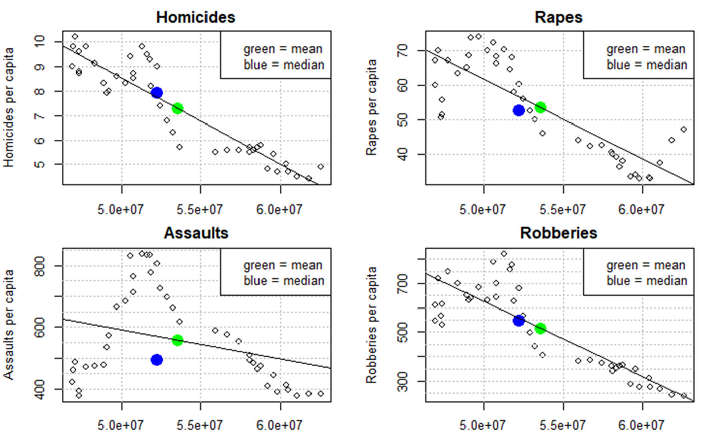
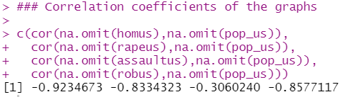
RESULTS
From investigating this data, we can start to make some connections between the population and the effect this has on the crime rate. From 1975 to around 1990, The number of violent crimes per capita increased each year, as did the population. However, in 1990 to 2015, the number of violent crimes overall decreased dramatically. Although the population was always increasing from 1995 to 2015, the number of violent crimes was still decreasing.
From the line diagram we compare the crime rate with population of each state we get a low positive correlation. When we compared the crime rate with changing population of the U.S from 1975 to 2015 we got a strong negative correlation. It shows that as the population of the U.S increases, the crimes per capita decreases.
From the scatter plot all of the above figures display a negative correlation between the year and number of per capita crimes of the 4 “violent” crimes, this meaning as time progressed all of the 4 crimes decreased per capita to varying effects.
We can interpret that assaults remained the highest crime throughout the period. It covers almost more than half of the area of the pie chart 57%. It is also displaying the greatest changes amongst the crimes. Small change is observed in the rapes (8%) and homicides(1%). From this graph it can be clearly seen that robberies is in the second highest crimes in United States. It covers 34% area in that graph.

Slide 4
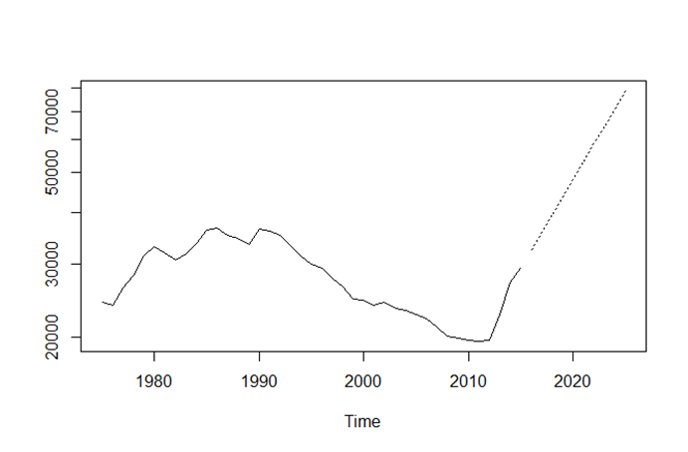
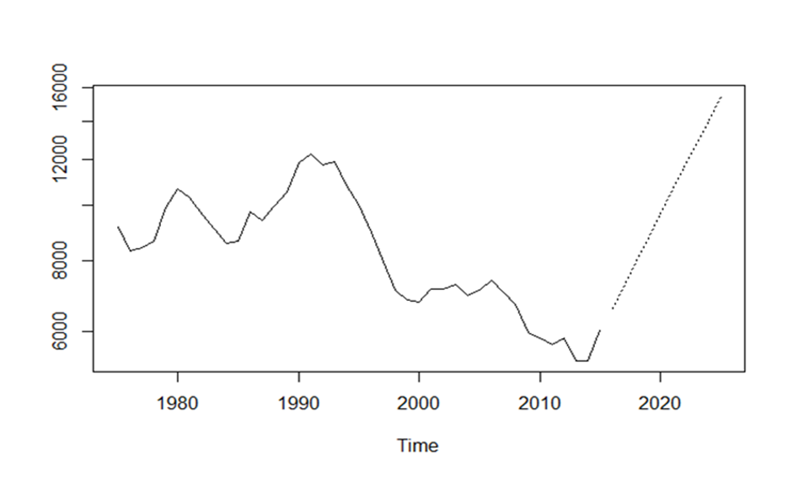
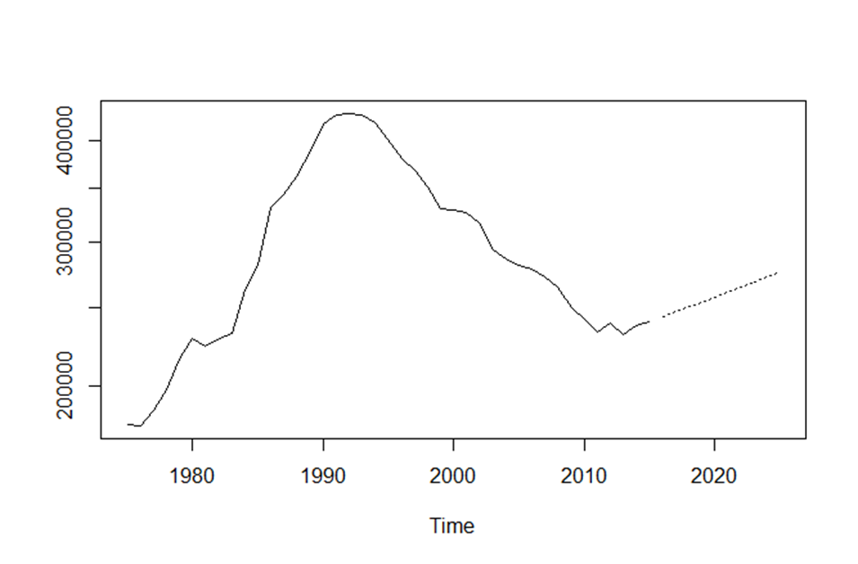
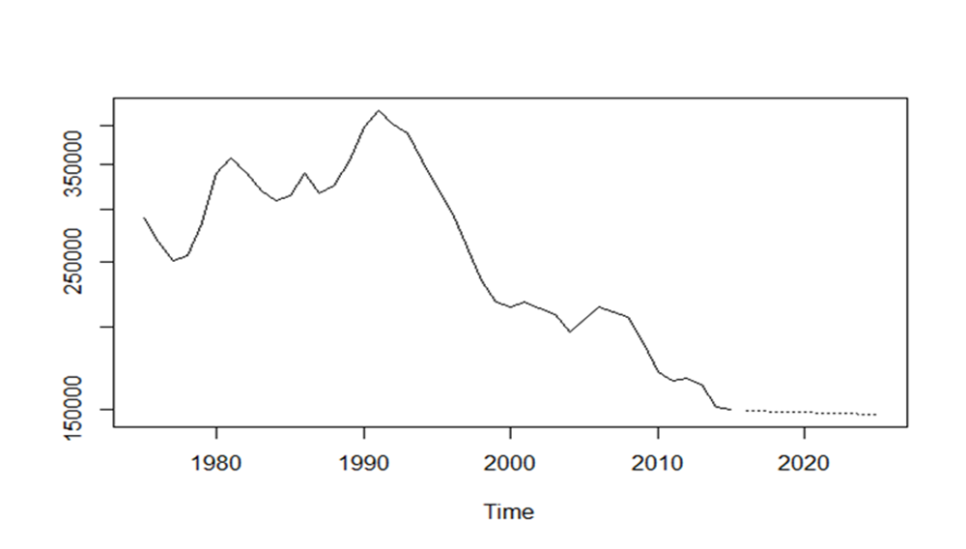
RAPES
HOMICIDES
ASSAULTS
ROBBERIES
CONCLUSION:
Time Series Analysis and Forecasting is performed with several visualizations and statistical models in this project. ARIMA models gave good forecasting for next ten years. According to forecasting results crimes like rapes, assults & homicides are slightly increasing and robberies are decreasing. This forecasting results can help police to take necessary precautions according to the crime rate. This helps tourists, students and immigrants to plan safer travels and stay safe during their stay. There are more thefts in US on streets from past 40 years. Government of USA can utilize these results to increase more police force. With this project work, This could help the targeted audience in understanding of how things are going to be for the foreseeable future with some confidence backed by the algorithms developed by geniuses. In my experience analyzing crime data, I developed a positive hope for safer future. This project excited me about the possible constructive impact it might create in future.
RESULT:-- We have fitted a ARIMA model. We have predicted values for next 10 yars. from ARIMA model we have predicted the future of four violent crimes. In upcoming years these violent crimes rapes, homicides and assults will be increasing and robberies will be decreasing.

Slide 5
THANK YOU

